Slide 1

Customer Shopping Behavior Analytics
Turning Customer Data into Actionable Business Insights

Slide 2
Executive Summary: Key Metrics at a Glance
3.9K
$233K
$59.76
Total Customers
Total Revenue
Avg Purchase
In the analyzed dataset
Across all purchases
Per transaction
3.75
43%
Avg Rating
Discount Usage
Out of 5.0
Of all purchases

Slide 3
The Business Questions We Answered
1
Category Revenue
Which categories drive the most revenue?
2
Gender Spending
How do male vs. female customers compare in spending?
3
Subscription Impact
Does subscription status affect purchase value?
4
Loyalty Segmentation
How does customer loyalty segment the base?
5
Discount Behavior
What is the impact of discounts on purchasing behavior?

Slide 4

Data & Technology Architecture
Source Data
Analysis
Preparation
A structured four-stage pipeline transforms raw customer records into interactive, decision-ready insights — from source data through preparation, SQL analysis, and final Power BI visualization.

Slide 5
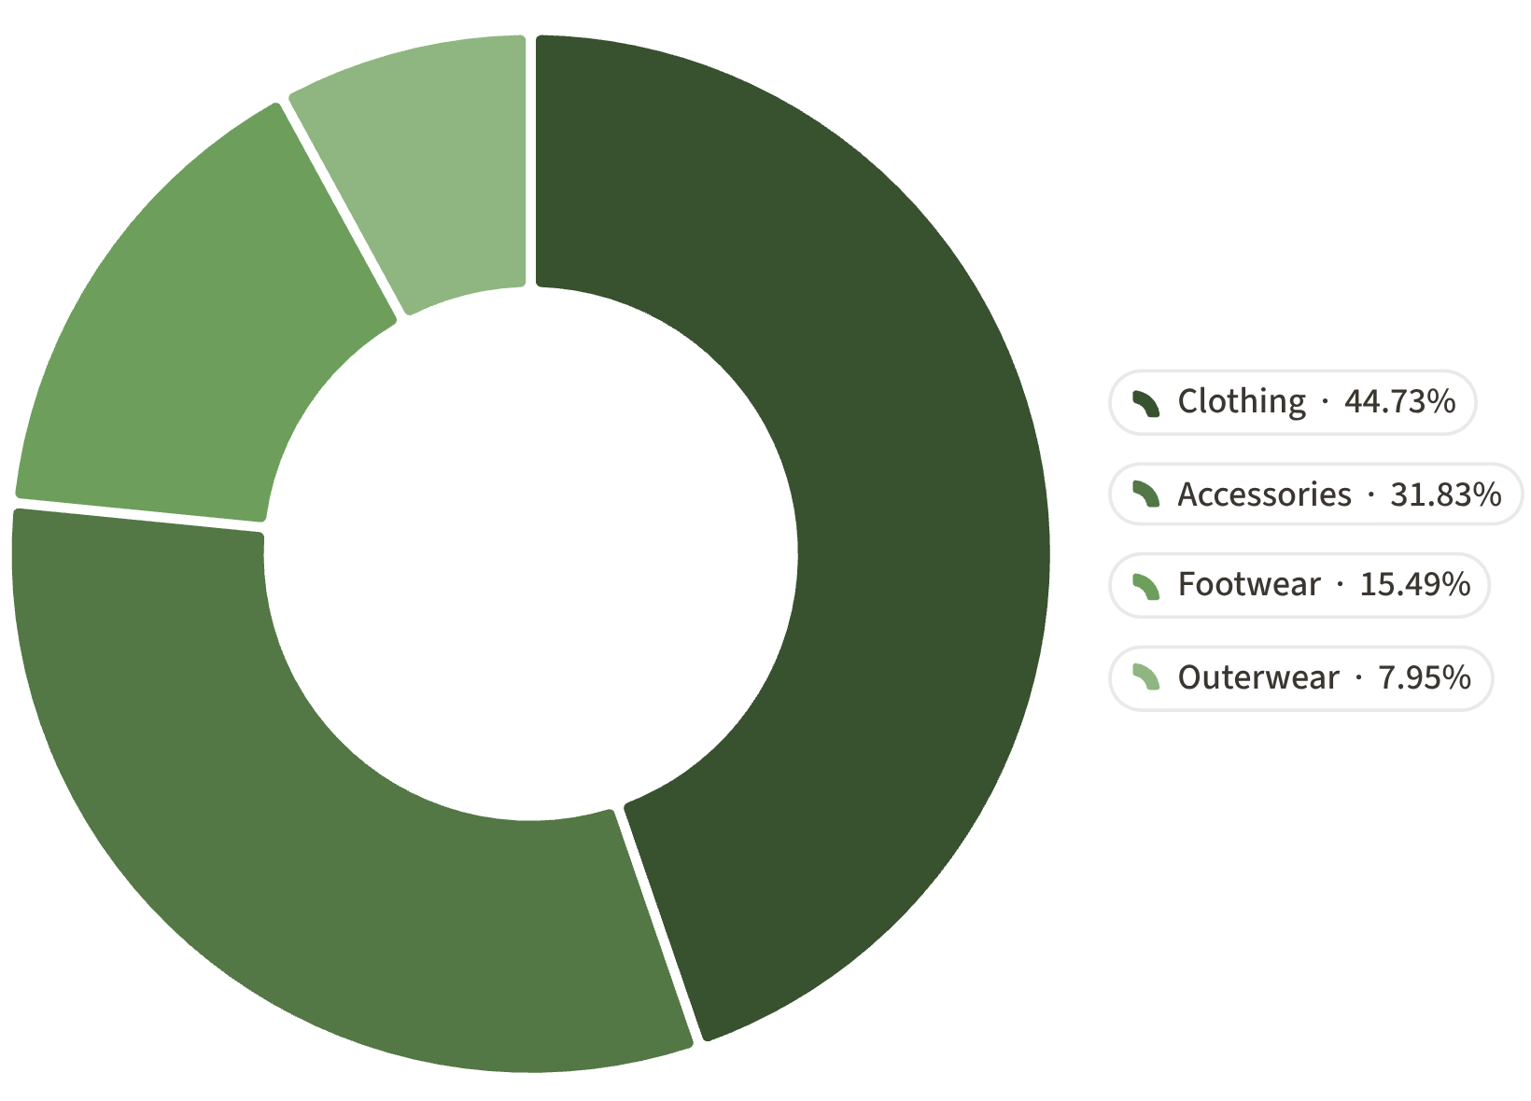

Clothing Drives the Largest Share of Observed Revenue
Revenue by Category
Clothing is the clear revenue leader, accounting for 45% of total observed revenue at $104,264. Accessories follow at 32% ($74,200), making these two categories together responsible for over three-quarters of all revenue.
Clothing — $104,264
Accessories — $74,200
Footwear — $36,093
Outerwear — $18,524
45% of total revenue
32% of total revenue
15% of total revenue
8% of total revenue

Slide 6

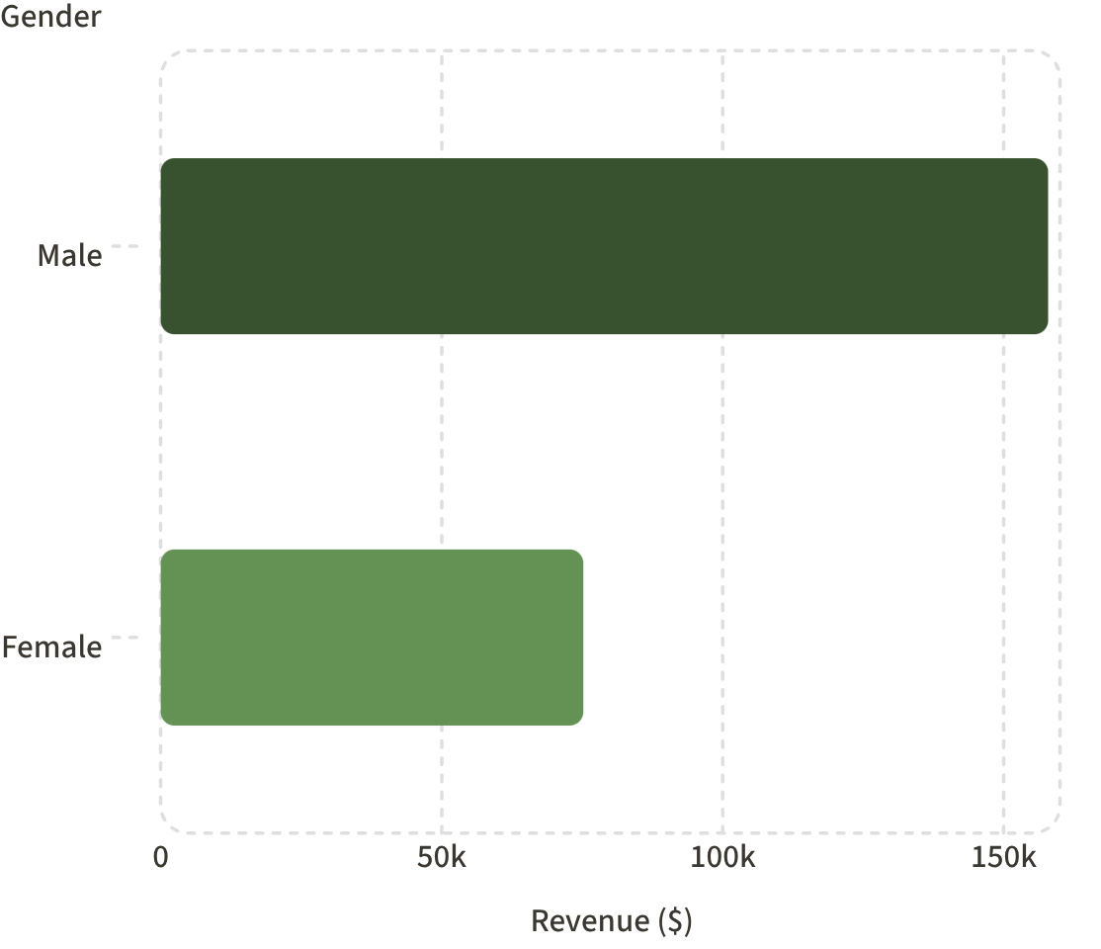

Male Customers Represent Larger Revenue Share
Revenue by Gender
This reflects customer composition in the dataset — male customers make up a larger share of the customer base — not a difference in spending per individual customer.

Slide 7



The Dataset Is Dominated by Returning and Loyal Customers
80%
18%
2%
Loyal Customers
Returning Customers
New Customers
3,116 customers with 10+ purchases — the core of the business
701 customers with 2–10 purchases — an engaged growth segment
83 customers with just 1 purchase — significant acquisition opportunity
Opportunity: With 80% of the base already loyal, deepening engagement through personalized programs offers the highest near-term return.

Slide 8
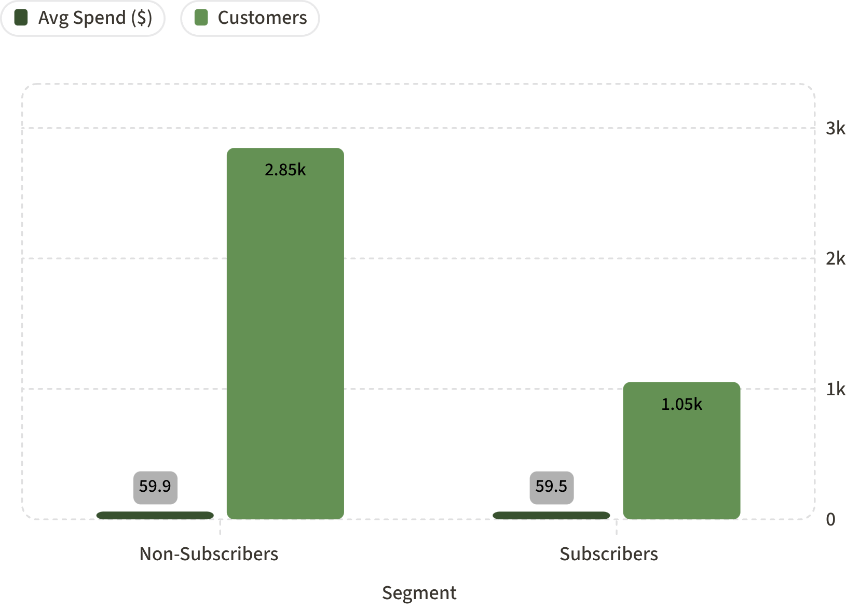

Subscription Status Shows Little Difference in Average Purchase Value
What the Data Shows
Non-subscribers (2,847 customers) average $59.87 per purchase, while subscribers (1,053 customers) average $59.49 — a difference of just $0.38.
Average order value alone does not differentiate these segments in a meaningful way.
Recommendation: Evaluate subscription strategy through retention rates and lifetime value, not average order value. The real benefit of subscriptions may lie in purchase frequency and long-term loyalty, not individual transaction size.

Slide 9


Promotions Are a Significant Part of Purchasing Behavior
Discount Penetration
Most Discounted Products
43%
1
2
Hat
Sneakers
of all purchases involved a discount or promotional offer.
This is a substantial share of transactions, raising an important strategic question: Are discounts driving incremental revenue, or are they primarily reducing margin on purchases that would have occurred anyway?
50.0% of purchases discounted
49.7% of purchases discounted
3
Coat
49.1% of purchases discounted

Slide 10

High-Rated Products Create Engagement Opportunities
With an overall average rating of 3.75 / 5, certain products stand out as clear customer favorites — and represent untapped merchandising potential.
🧤 Gloves
👡 Sandals
3.86 / 5 — Highest rated product in the dataset. Strong candidate for featured placement and cross-sell campaigns.
3.84 / 5 — Second highest rating. Ideal for seasonal promotions and customer testimonial features.
👢 Boots
3.82 / 5 — Third highest rating. High satisfaction signals cross-sell potential with complementary accessories.

Slide 11





Five Strategic Recommendations
Strengthen Loyalty Programs
Optimize Discount Strategy
Promote High-Rated Products
Introduce VIP benefits, personalized offers, and early access for the 80% loyal customer base — the highest-return segment available.
Measure incremental revenue, margin impact, and frequency effects. With 43% discount penetration, understanding true ROI is critical.
Feature Gloves, Sandals, and Boots in merchandising, recommendation engines, and marketing campaigns to leverage proven satisfaction.
Improve Subscription Conversion
Segment-Based Campaigns
Reframe the subscription value proposition around retention and lifetime value rather than average order value, which shows no meaningful difference.
Tailor messaging and offers for new (2%), returning (18%), and loyal (80%) customers — each segment has distinct needs and growth potential.

